Slide 1
Chapter 2 – Software Processes

Slide 2
Topics covered
Software process models
Process activities
Coping with change
Process improvement

Slide 3
The software process
A structured set of activities required to develop a software system.
Many different software processes but all involve:
Specification – defining what the system should do;
Design and implementation – defining the organization of the system and implementing the system;
Validation – checking that it does what the customer wants;
Evolution – changing the system in response to changing customer needs.
A software process model is an abstract representation of a process. It presents a description of a process from some particular perspective.

Slide 4
Software process descriptions
When we describe and discuss processes, we usually talk about the activities in these processes such as specifying a data model, designing a user interface, etc. and the ordering of these activities.
Process descriptions may also include:
Products, which are the outcomes of a process activity;
Roles, which reflect the responsibilities of the people involved in the process;
Pre- and post-conditions, which are statements that are true before and after a process activity has been enacted or a product produced.

Slide 5
Plan-driven and agile processes
Plan-driven processes are processes where all of the process activities are planned in advance and progress is measured against this plan.
In agile processes, planning is incremental and it is easier to change the process to reflect changing customer requirements.
In practice, most practical processes include elements of both plan-driven and agile approaches.
There are no right or wrong software processes.

Slide 6
Software process models

Slide 7
Software process models
The waterfall model
Plan-driven model. Separate and distinct phases of specification and development.
Incremental development
Specification, development and validation are interleaved. May be plan-driven or agile.
Integration and configuration
The system is assembled from existing configurable components. May be plan-driven or agile.
In practice, most large systems are developed using a process that incorporates elements from all of these models.

Slide 8
The waterfall model

Slide 9
Waterfall model phases
There are separate identified phases in the waterfall model:
Requirements analysis and definition
System and software design
Implementation and unit testing
Integration and system testing
Operation and maintenance
The main drawback of the waterfall model is the difficulty of accommodating change after the process is underway. In principle, a phase has to be complete before moving onto the next phase.

Slide 10
It is often difficult for the customer to state all requirements explicitly.
The customer must have patience. A working version of the program(s) will not be available until late in the project time span. A major blunder, if undetected until the working program is reviewed, can be disastrous.

Slide 11
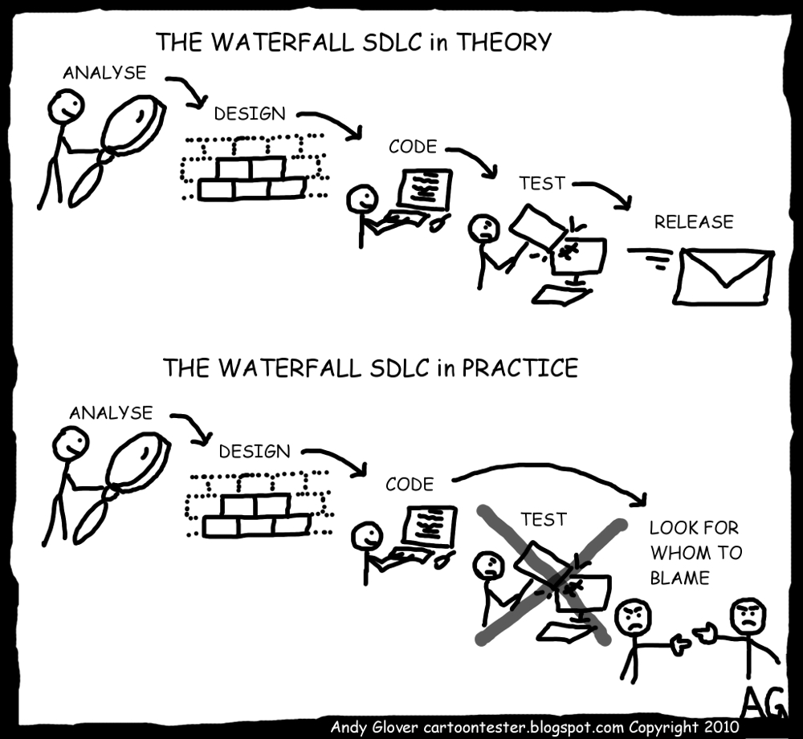
Waterfall Model

Slide 12
Waterfall model problems
Inflexible partitioning of the project into distinct stages makes it difficult to respond to changing customer requirements.
Therefore, this model is only appropriate when the requirements are well-understood and changes will be fairly limited during the design process.
Few business systems have stable requirements.
The waterfall model is mostly used for large systems engineering projects where a system is developed at several sites.
In those circumstances, the plan-driven nature of the waterfall model helps coordinate the work.

Slide 13
Waterfall Model
In an interesting analysis of actual projects, Bradac [Bra94] found that the linear nature of the classic life cycle leads to “blocking states” in which some project team members must wait for other members of the team to complete dependent tasks. In fact, the time spent waiting can exceed the time spent on productive work! The blocking states tend to be more prevalent at the beginning and end of a linear sequential process.

Slide 14
Side note (Modified Waterfall)
Requirements specification
Architectural design
Detailed design
Coding and unit testing
Integration and testing
Operation and maintenance

Slide 15
Incremental development

Slide 16
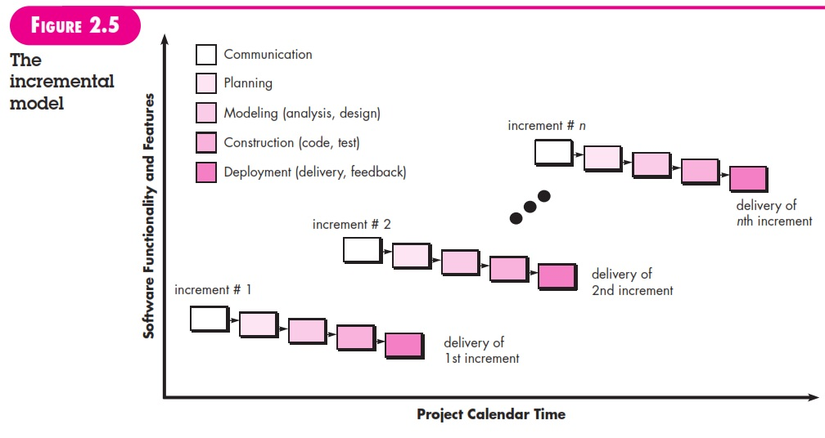
Incremental Model …2nd diagram

Slide 17
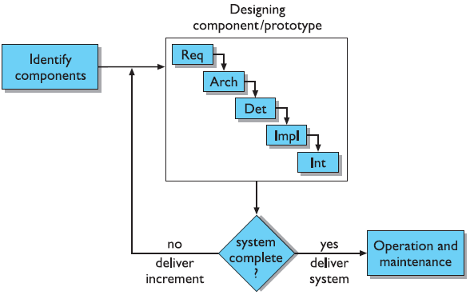
Incremental model…3rd diagram

Slide 18
Incremental development benefits
The cost of accommodating changing customer requirements is reduced.
The amount of analysis and documentation that has to be redone is much less than is required with the waterfall model.
It is easier to get customer feedback on the development work that has been done.
Customers can comment on demonstrations of the software and see how much has been implemented.
More rapid delivery and deployment of useful software to the customer is possible.
Customers are able to use and gain value from the software earlier than is possible with a waterfall process.

Slide 19
Incremental development problems
The process is not visible.
Managers need regular deliverables to measure progress. If systems are developed quickly, it is not cost-effective to produce documents that reflect every version of the system.
System structure tends to degrade as new increments are added.
Unless time and money is spent on refactoring to improve the software, regular change tends to corrupt its structure. Incorporating further software changes becomes increasingly difficult and costly.

Slide 20
Incremental Model
To provide a limited set of software functionality to users quickly and then refine and expand on that functionality in later software releases.
Each linear sequence produces deliverable “increments” of the software.
The incremental process model focuses on the delivery of an operational product with each increment.
Supplementary features (some known, others unknown) remain undelivered.

Slide 21
When Should Incremental be Used
Incremental development is particularly useful when staffing is unavailable for a complete implementation by the business deadline that has been established for the project. Early increments can be implemented with fewer people. If the core product is well received, then additional staff (if required) can be added to implement the next increment. In addition, increments can be planned to manage technical risks. For example, a major system might require the availability of new hardware that is under development and whose delivery date is uncertain. It might be possible to plan early increments in a way that avoids the use of this hardware, thereby enabling partial functionality to be delivered to end users without inordinate delay.

Slide 22
Integration and configuration
Based on software reuse where systems are integrated from existing components or application systems (sometimes called COTS -Commercial-off-the-shelf) systems).
Reused elements may be configured to adapt their behaviour and functionality to a user’s requirements
Reuse is now the standard approach for building many types of business system
Reuse covered in more depth in Chapter 15.

Slide 23
Types of reusable software
Stand-alone application systems (sometimes called COTS) that are configured for use in a particular environment.
Collections of objects that are developed as a package to be integrated with a component framework such as .NET or J2EE.
Web services that are developed according to service standards and which are available for remote invocation.

Slide 24
Reuse-oriented software engineering

Slide 25
Key process stages
Requirements specification
Software discovery and evaluation
Requirements refinement
Application system configuration
Component adaptation and integration

Slide 26
Advantages and disadvantages
Reduced costs and risks as less software is developed from scratch
Faster delivery and deployment of system
But requirements compromises are inevitable so system may not meet real needs of users
Loss of control over evolution of reused system elements

Slide 27
Process activities

Slide 28
Process activities
Real software processes are inter-leaved sequences of technical, collaborative and managerial activities with the overall goal of specifying, designing, implementing and testing a software system.
The four basic process activities of specification, development, validation and evolution are organized differently in different development processes.
For example, in the waterfall model, they are organized in sequence, whereas in incremental development they are interleaved.

Slide 29
The requirements engineering process

Slide 30
Software specification
The process of establishing what services are required and the constraints on the system’s operation and development.
Requirements engineering process
Requirements elicitation and analysis
What do the system stakeholders require or expect from the system?
Requirements specification
Defining the requirements in detail
Requirements validation
Checking the validity of the requirements

Slide 31
Software design and implementation
The process of converting the system specification into an executable system.
Software design
Design a software structure that realises the specification;
Implementation
Translate this structure into an executable program;
The activities of design and implementation are closely related and may be inter-leaved.

Slide 32
A general model of the design process

Slide 33
Design activities
Architectural design, where you identify the overall structure of the system, the principal components (subsystems or modules), their relationships and how they are distributed.
Database design, where you design the system data structures and how these are to be represented in a database.
Interface design, where you define the interfaces between system components.
Component selection and design, where you search for reusable components. If unavailable, you design how it will operate.

Slide 34
System implementation
The software is implemented either by developing a program or programs or by configuring an application system.
Design and implementation are interleaved activities for most types of software system.
Programming is an individual activity with no standard process.
Debugging is the activity of finding program faults and correcting these faults.

Slide 35
Software validation
Verification and validation (V & V) is intended to show that a system conforms to its specification and meets the requirements of the system customer.
Involves checking and review processes and system testing.
System testing involves executing the system with test cases that are derived from the specification of the real data to be processed by the system.
Testing is the most commonly used V & V activity.

Slide 36
Stages of testing

Slide 37
Testing stages
Component testing
Individual components are tested independently;
Components may be functions or objects or coherent groupings of these entities.
System testing
Testing of the system as a whole. Testing of emergent properties is particularly important.
Customer testing
Testing with customer data to check that the system meets the customer’s needs.

Slide 38
Testing phases in a plan-driven software process (V-model)

Slide 39
Software evolution
Software is inherently flexible and can change.
As requirements change through changing business circumstances, the software that supports the business must also evolve and change.
Although there has been a demarcation between development and evolution (maintenance) this is increasingly irrelevant as fewer and fewer systems are completely new.

Slide 40
System evolution

Slide 41
Coping with change

Slide 42
Coping with change
Change is inevitable in all large software projects.
Business changes lead to new and changed system requirements
New technologies open up new possibilities for improving implementations
Changing platforms require application changes
Change leads to rework so the costs of change include both rework (e.g. re-analysing requirements) as well as the costs of implementing new functionality

Slide 43
Reducing the costs of rework
Change anticipation, where the software process includes activities that can anticipate possible changes before significant rework is required.
For example, a prototype system may be developed to show some key features of the system to customers.
Change tolerance, where the process is designed so that changes can be accommodated at relatively low cost.
This normally involves some form of incremental development. Proposed changes may be implemented in increments that have not yet been developed. If this is impossible, then only a single increment (a small part of the system) may have be altered to incorporate the change.

Slide 44
Coping with changing requirements
System prototyping, where a version of the system or part of the system is developed quickly to check the customer’s requirements and the feasibility of design decisions. This approach supports change anticipation.
Incremental delivery, where system increments are delivered to the customer for comment and experimentation. This supports both change avoidance and change tolerance.

Slide 45
Software prototyping
A prototype is an initial version of a system used to demonstrate concepts and try out design options.
A prototype can be used in:
The requirements engineering process to help with requirements elicitation and validation;
In design processes to explore options and develop a UI design;
In the testing process to run back-to-back tests.

Slide 46
Benefits of prototyping
Improved system usability.
A closer match to users’ real needs.
Improved design quality.
Improved maintainability.
Reduced development effort.

Slide 47
The process of prototype development

Slide 48
Prototype development
May be based on rapid prototyping languages or tools
May involve leaving out functionality
Prototype should focus on areas of the product that are not well-understood;
Error checking and recovery may not be included in the prototype;
Focus on functional rather than non-functional requirements such as reliability and security

Slide 49
Throw-away prototypes
Prototypes should be discarded after development as they are not a good basis for a production system:
It may be impossible to tune the system to meet non-functional requirements;
Prototypes are normally undocumented;
The prototype structure is usually degraded through rapid change;
The prototype probably will not meet normal organisational quality standards.

Slide 50
Incremental delivery
Rather than deliver the system as a single delivery, the development and delivery is broken down into increments with each increment delivering part of the required functionality.
User requirements are prioritised and the highest priority requirements are included in early increments.
Once the development of an increment is started, the requirements are frozen though requirements for later increments can continue to evolve.

Slide 51
Incremental development and delivery
Incremental development
Develop the system in increments and evaluate each increment before proceeding to the development of the next increment;
Normal approach used in agile methods;
Evaluation done by user/customer proxy.
Incremental delivery
Deploy an increment for use by end-users;
More realistic evaluation about practical use of software;
Difficult to implement for replacement systems as increments have less functionality than the system being replaced.

Slide 52
Incremental delivery

Slide 53
Incremental delivery advantages
Customer value can be delivered with each increment so system functionality is available earlier.
Early increments act as a prototype to help elicit requirements for later increments.
Lower risk of overall project failure.
The highest priority system services tend to receive the most testing.

Slide 54
Incremental delivery problems
Most systems require a set of basic facilities that are used by different parts of the system.
As requirements are not defined in detail until an increment is to be implemented, it can be hard to identify common facilities that are needed by all increments.
The essence of iterative processes is that the specification is developed in conjunction with the software.
However, this conflicts with the procurement model of many organizations, where the complete system specification is part of the system development contract.

Slide 55
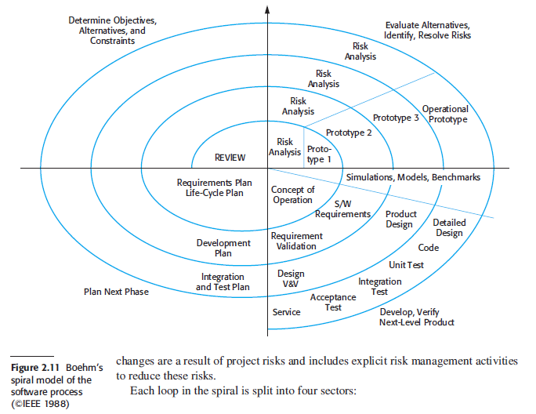
Spiral Model

Slide 56
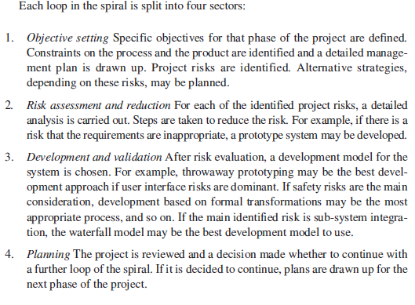

Slide 57
Rational Unified Process
The RUP is a phased model that identifies four discrete phases in the software process. However, unlike the waterfall model where phases are equated with process activities, the phases in the RUP are more closely related to business rather than technical concerns.

Slide 58
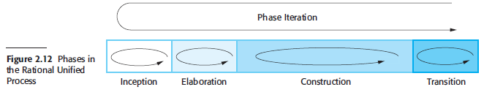
Rational Unified Process

Slide 59
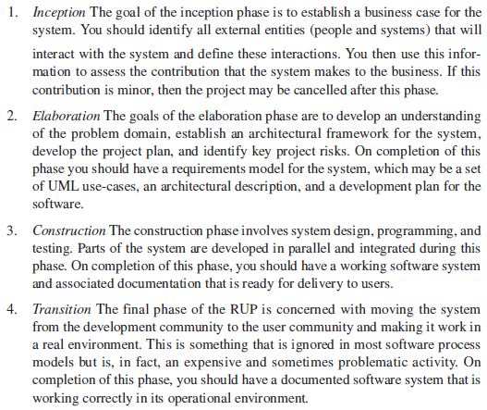

Slide 60
Process improvement

Slide 61
Process improvement
Many software companies have turned to software process improvement as a way of enhancing the quality of their software, reducing costs or accelerating their development processes.
Process improvement means understanding existing processes and changing these processes to increase product quality and/or reduce costs and development time.

Slide 62
Approaches to improvement
The process maturity approach, which focuses on improving process and project management and introducing good software engineering practice.
The level of process maturity reflects the extent to which good technical and management practice has been adopted in organizational software development processes.
The agile approach, which focuses on iterative development and the reduction of overheads in the software process.
The primary characteristics of agile methods are rapid delivery of functionality and responsiveness to changing customer requirements.

Slide 63
The process improvement cycle

Slide 64
Process improvement activities
Process measurement
You measure one or more attributes of the software process or product. These measurements forms a baseline that helps you decide if process improvements have been effective.
Process analysis
The current process is assessed, and process weaknesses and bottlenecks are identified. Process models (sometimes called process maps) that describe the process may be developed.
Process change
Process changes are proposed to address some of the identified process weaknesses. These are introduced and the cycle resumes to collect data about the effectiveness of the changes.

Slide 65
Process measurement
Wherever possible, quantitative process data should be collected
However, where organisations do not have clearly defined process standards this is very difficult as you don’t know what to measure. A process may have to be defined before any measurement is possible.
Process measurements should be used to assess process improvements
But this does not mean that measurements should drive the improvements. The improvement driver should be the organizational objectives.

Slide 66
Process metrics
Time taken for process activities to be completed
E.g. Calendar time or effort to complete an activity or process.
Resources required for processes or activities
E.g. Total effort in person-days.
Number of occurrences of a particular event
E.g. Number of defects discovered.

Slide 67
Capability maturity levels

Slide 68
The SEI capability maturity model
Initial: Essentially uncontrolled, chaotic, ad hoc, and unpredictable. No standardized processes are in place
Managed: Basic product management procedures defined and used to track cost, schedule, and functionality
Defined: Process management procedures and strategies are standardized and used
Quantitatively Managed: Processes are measured and controlled using quantitative data
Optimising: Continuous process improvement is ingrained in the organizational culture, Organizational Innovation, Causal Analysis

Slide 69
Key points
Software processes are the activities involved in producing a software system. Software process models are abstract representations of these processes.
General process models describe the organization of software processes.
Examples of these general models include the ‘waterfall’ model, incremental development, and reuse-oriented development.
Requirements engineering is the process of developing a software specification.

Slide 70
Key points
Design and implementation processes are concerned with transforming a requirements specification into an executable software system.
Software validation is the process of checking that the system conforms to its specification and that it meets the real needs of the users of the system.
Software evolution takes place when you change existing software systems to meet new requirements. The software must evolve to remain useful.
Processes should include activities such as prototyping and incremental delivery to cope with change.

Slide 71
Key points
Processes may be structured for iterative development and delivery so that changes may be made without disrupting the system as a whole.
The principal approaches to process improvement are agile approaches, geared to reducing process overheads, and maturity-based approaches based on better process management and the use of good software engineering practice.
The SEI process maturity framework identifies maturity levels that essentially correspond to the use of good software engineering practice.

